Slide 1
AUTObREW: Automated all grain homebrewing system
Nick Anderson

Slide 2
Brewing Process
All Grain Brewing
Requires 4 vessels
Hot Liquor Tank
Used to heat water
Mash Tun
Used to convert water and grains, into liquid with fermentable sugars
Brew Pot
Used to sanitize the liquid fermentable sugars (remove bacteria) and apply hops and any other additional ingredients
Fermenter
Used to convert the fermentable sugars into alcohol and allow solids still in wort to settle down for filtering
Traditional process requires siphoning between hot liquor tank/mash tun, and brew pot/fermenter
Mash tun/Brew pot transition done by gravity feed
Mash tun must be elevated above brew pot

Slide 3
Brewing Process
Entire process can take >4 hours
Most of the time spent hands on
Siphoning, lifting, checking temperatures, monitoring fluid levels
Automation of process would reduce hands on time
Hands on required for
Adding/removing grains
Removing liquid from fermenter
Swapping hoses for mashing/sparging
Monitoring fluid process/reaction

Slide 4
Automated Process Overview
Requires a microcontroller to handle monitoring of levels and temperatures, and controlling pumps and valves.
Dependent on state machine
Microcontroller would talk via network communications to a GUI
GUI would be a programmed developed on PC to allow the user to set up temperatures and time durations prior to brew start.

Slide 5
Automated Brew Setup - Hardware

Slide 6
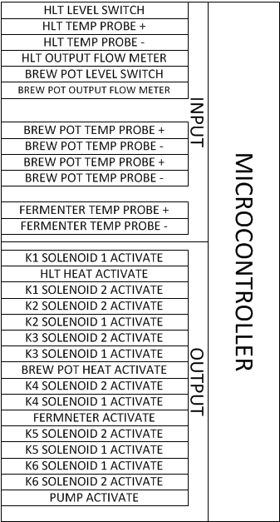
Automated Brew Setup – Inputs
Inputs
Level Float Switches
Contact Closure (digital hi/lo input)
HLT
Brew Pot
Temperature Probes
Thermocouple
HLT
Mash Tun
Brew Pot
Fermenter
Flow Meter
Determines when all liquid has been drained from vessel
Hall Effect Pulse
HLT
Brew Pot

Slide 7
Automated Brew Setup – Outputs
Outputs
Solenoid Activates
Controls plumbing routes
Power Relay
Controls Heating Elements
Controls Pump Activation
Cooling Element Activation

Slide 8
Brew Process – Step 1
Filling Hot Liquor Tank
Activate K1 to allow water source to fill HLT until level switch is activated.

Slide 9
Brew Process – Step 2
Heat HLT to temperature setpoint
Activate Power Relay to turn on heating element until temperature reaches setpoint

Slide 10
Brew Process – Step 3
Transfer water from HLT to Mash Tun
Activate K2 to allow flow from HLT to Mash Tun until no flow is seen on flow meter.

Slide 11
Brew Process – Step 4
Keep temperature in Mash Tun at consistent temperature, either through letting liquid sit in Mash Tun, or filling HLT with water, heating, and running Mash Tun liquid through coils in HLT to transfer heat from HLT to Mash Tun liquid.

Slide 12
Brew Process – Step 5
Transfer fluid from Mash Tun into Brew pot, while adding water from HLT to Mash Tun to make sure liquid in Brew Pot reaches desired fluid level.

Slide 13
Brew Process – Step 6
Heat up Liquid in Brew Pot to a rolling boil.

Slide 14
Brew Process – Step 7
Cool liquid in Brew Pot by putting cold water through wort chiller in brew pot. Exhaust from Wort Chiller (will be warm/hot from heat transfer) would go into HLT and exit out of overflow valve. When level in HLT reaches level switch, heating element will turn on to heat water for cleaning. Also pump liquid out of brew pot, and back into brew pot to aid in circulation of liquid, and heat loss.

Slide 15
Brew Process – Step 8
Transfer cooled liquid into fermenter until flow meter indicates there is no more liquid in brew pot.

Slide 16
Brew Process – Step 9
Control temperature of fermenter by measuring temperature, and controlling power relay to cooling device

Slide 17
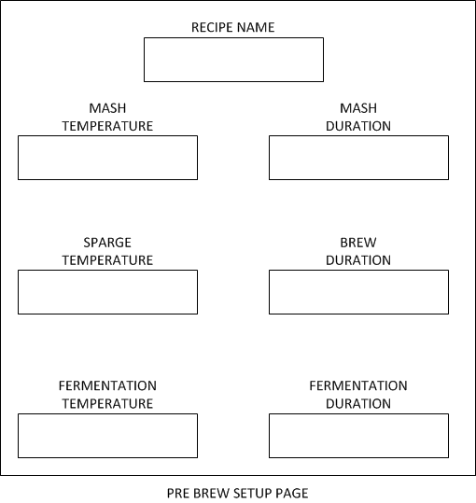
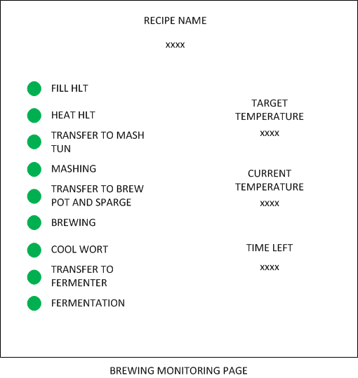
GUI
Will allow user to set up temperatures and time durations prior to starting process, and monitor state, temperature and time during.

Slide 18
Issues
Plumbing
Solenoid valves with desired configuration
Ensuring all components are food grade
Electrical
Examine power draw for all components
Continuous and Inrush
Determine order that components should be turned on
Determines if single 120VAC or 240VAC source is required.
Select microcontroller with adequate I/O to control devices with spare for unseen issues
Mechanical
Create a frame to mount vessels and parts to allow for gravity fed legs where required.

